Slide 1
Predictive Climate Insights (PCI) Project Overview

Slide 2
Contents:
Objectives
Motivation
System Design
Results
Conclusion

Slide 3

Objectives:
User-Friendly Weather App:
Develop an app for accurate forecasts of rainfall, sunshine duration, temperature, and humidity.
Robust Rainfall Model:
Create a reliable rainfall prediction model using historical data.
Machine Learning Accuracy:
Enhance prediction accuracy with machine learning algorithms.
Model Evaluation:
Evaluate and validate the model for agriculture and disaster response.
Comprehensive Forecasting:
Integrate rainfall and solar power predictions for holistic weather forecasting.
Intuitive Interface:
Design an intuitive, user-friendly application interface.
Real-Time Data:
Incorporate real-time data for improved prediction accuracy.

Slide 4
Motivation
Weather Impact on Bangladesh:
Critical for Bangladesh's economy.
Significant impact on agriculture, droughts, floods, and landslides.
Floods can accelerate the spread of diseases and damage crops.
Impact on Solar Power Generation:
Helps energy companies manage solar systems, reduce costs, and improve efficiency.
Climate Pattern Understanding:
Contributes to understanding climate changes and seasonal diseases.
Aids informed decision-making for farmers, energy planners, and individuals.
Enhances agricultural productivity and secures food and water supply.
The Predictive Climate Insights (PCI) project aims to Machine Learning (ML) applications in weather and climate prediction—a field of growing importance across multiple sectors, including agriculture and disaster management.

Slide 5
Literature review
Title | Authors | Objective/ Purpose | Methodology/Approach | Key Findings/ Results | Limitations | Publication Year | Main Focus
“Machine Learning-Based Rainfall Prediction: Unveiling Insights and Forecasting for Improved Preparedness” | MD. MEHEDI HASSAN , MOHAMMAD ABU TAREQ RONY,MD. ASIF RAKIB KHAN,MD. MAHEDI HASSAN,ANINDYA NAG,ANUPAM KUMAR BAIRAGI,SAMAH ALSHATHRI,TAZRIA HELAL ZARIN | Utilize machine learning for accurate rainfall prediction, considering the impact of scarcity or extreme rainfall on rural and urban life. | Employ data preprocessing, outlier analysis, correlation analysis, feature selection, and various ML algorithms (Naive Bayes, Decision Tree, SVM, Random Forest, Logistic Regression) | Artificial Neural Network achieves a maximum accuracy of 91%. K-means clustering and PCA examine regional rainfall patterns. | Focus on Australian weather data, may have limited generalizability | 2023 | Rainfall prediction for improved preparedness
Solar Power Prediction Using Machine Learning | E. Subramanian, M.Mithun Karthik ,G.Prem,Krishna,V.Sugesh Kumar, D. Vaisnav Prasat | Develop a machine learning-based approach for predicting solar power generation with high accuracy. | Collect and preprocess high-quality data, select relevant features, and use SVM, Random Forest, and Gradient Boosting for predictions. | Achieve a 99% AUC for solar power generation prediction. Improve energy efficiency and reduce costs for energy companies. | Limited to solar power generation, may not consider other factors affecting energy production. | 2021 | Solar power generation prediction
Prediction of Temperature and Rainfall in Bangladesh | Mohammad Mahmudur Rahman Khan , Anas Aziz ,Md. Abu Bakr Siddique , Ihtyaz Kader Tasawar ,Shadman Sakib , Ziad Hossain | Implement a Long Short-Term Memory (LSTM) model to forecast monthwise temperature and rainfall in Bangladesh. | Analyze 115 years of weather data, use LSTM for forecasting, and assess mean error for temperature and rainfall predictions. | LSTM model shows mean error of -0.38°C for temperature and -17.64mm for rainfall predictions. | Focus on historical data (1901-2015), may not capture recent climate changes | 2019 | Temperature and rainfall prediction in Bangladesh
Standardizatio-n Of Rainfall Prediction In Bangladesh | Nushrat Jahan Ria ,Jannatul Ferdous Ani ,Mirajul Islam ,Abu Kaisar Mohammad Masum | Develop a rain prediction model using Machine Learning and evaluate multiple models. | Use a dataset from Bangladesh Jatiyo Tottho Batayon, train and validate models (Random Forest, among others), and assess performance. | Random Forest classifier provides the most accurate rainfall predictions, achieving higher Accuracy, Recall, Precision, and F1 Score. | Limited to data from Bangladesh Jatiyo Tottho Batayon, may not represent the entire country. | 2020 | Rainfall prediction using Machine Learning
Machine Learning Model on Rainfall - A Predicted Approach for Bangladesh | Yousuf Zaman,Suman Ahmed ,Mohammad Moniruzzaman , Novia Nurain | Develop machine learning models for long-term rainfall prediction in Bangladesh divisions and districts. | Use regression analysis algorithms (Linear Regression, Random Forest Regression) and classification algorithms (Naive Bayes, Decision Tree, Random Forest). | Models predict rainfall in advance with accuracy above 65%. Apache Spark library is used for machine learning in Scala. | Limited to specific regions in Bangladesh, may not generalize to the entire country. | 2022 | Long-term rainfall prediction in Bangladesh
Machine Learning Methods in Weather and Climate Applications: A Survey | Liuyi Chen1, Bocheng Han1, Xuesong Wang2, Jiazhen Zhao3, Wenke Yang1and Zhengyi Yan | Survey machine learning applications in weather and climate prediction, highlighting promising techniques. | Review more than 20 methods, pinpoint eight techniques with promise, and assess ML capabilities in short-term weather and medium-to-long-term climate forecasting. | ML shows significant capabilities in short-term weather prediction, but limited application in medium-to-long-term climate forecasting. | General limitations of machine learning in climate forecasting due to intricate variables and data limitations. | 2020 | Survey of machine learning applications in weather and climate prediction

Slide 6
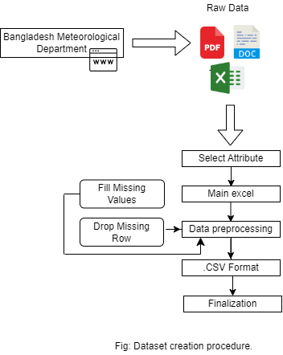
System Design(part A)
1.Data Origin:
Bangladesh Climate Database sourced from data.gov.bd.
Government repository for climate-related data covering various meteorological parameters
Data Collection and Preprocessing:
Compilation of historical weather data from meteorological stations across Bangladesh.
Historical weather data (rainfall, sunshine, etc.) collected from various stations in Bangladesh.
Observations recorded at regular intervals (daily, monthly, yearly) for multiple weather variables.
Data preprocessing steps include filtering out invalid dates and creating datetime indices for the Data Frame.
2.Feature Engineering:
Extract relevant features from the dataset, such as day of the month, day of the year, etc.
Feature selection techniques employed to identify the most influential variables for weather prediction.

Slide 7

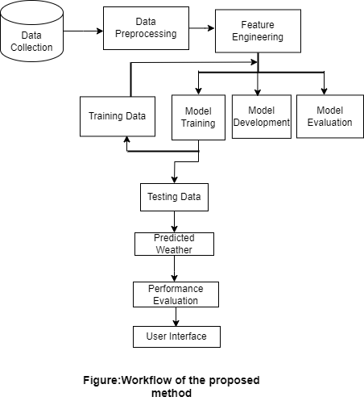
3.Model Training and Evaluation:
Several machine learning models are trained on the preprocessed data, including:
Support Vector Regression (SVR)
K-Nearest Neighbors (KNN)
Multi-Layer Perceptron (MLP) Classifier
Models are evaluated using appropriate metrics such as Mean Squared Error (MSE) and visual inspection of actual vs. predicted values.

Slide 8
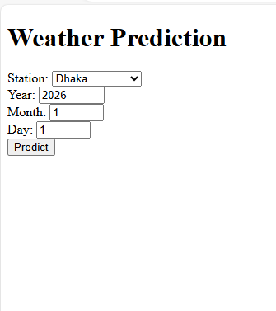
System Design(part B)
Web application
Weather Prediction Application Development:
Developed a web application for real-time weather
predictions using ML models.
Created a user-friendly interface for forecasts.
Integrated ML models for accurate predictions.
Ensured real-time data integration and accessibility.
User Interface (UI)
Interactive Web App: User-friendly interface for analysis.
User Selection: Choose specific chat participants for analysis.
Analysis Triggers: Button to initiate analysis and generate insights.

Slide 9
Technologies Used:
Frontend: HTML, CSS,Js
Backend: Flask used
Deployed Flask for web framework
Displayed both input and output of the model in the interface
Integrated advanced ML models for accurate predictions

Slide 10
Part A

Slide 11
Result:
1
2
Mean Squared Error (MSE), R^2 score used to quantify model performance.
Comparative analysis of model performance based on these metrics.
Model Performance:
Detailed analysis of each trained model's performance:
Support Vector Regression (SVM)
K-Nearest Neighbors (KNN)
Multi-Layer Perceptron (MLP) Classifier , decision tree.
Visualization of actual vs. predicted values for different weather parameters (e.g., rainfall, sunshine , max temp , min temp , humidity).

Slide 12
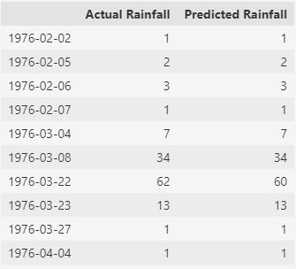
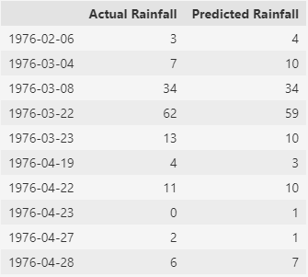
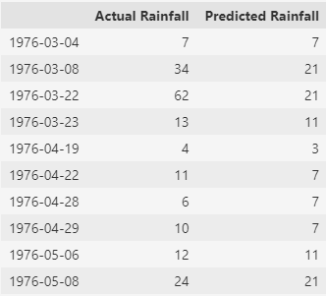
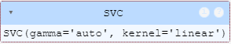
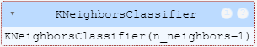
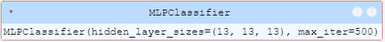
Result:
Difference between the performance of 3 model training methods

Slide 13
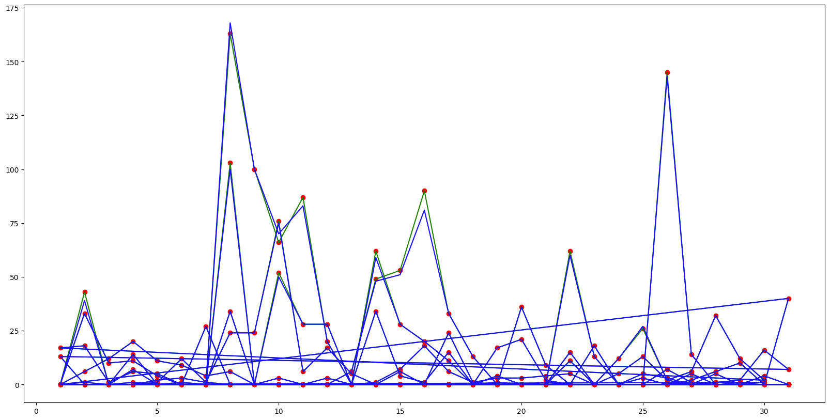
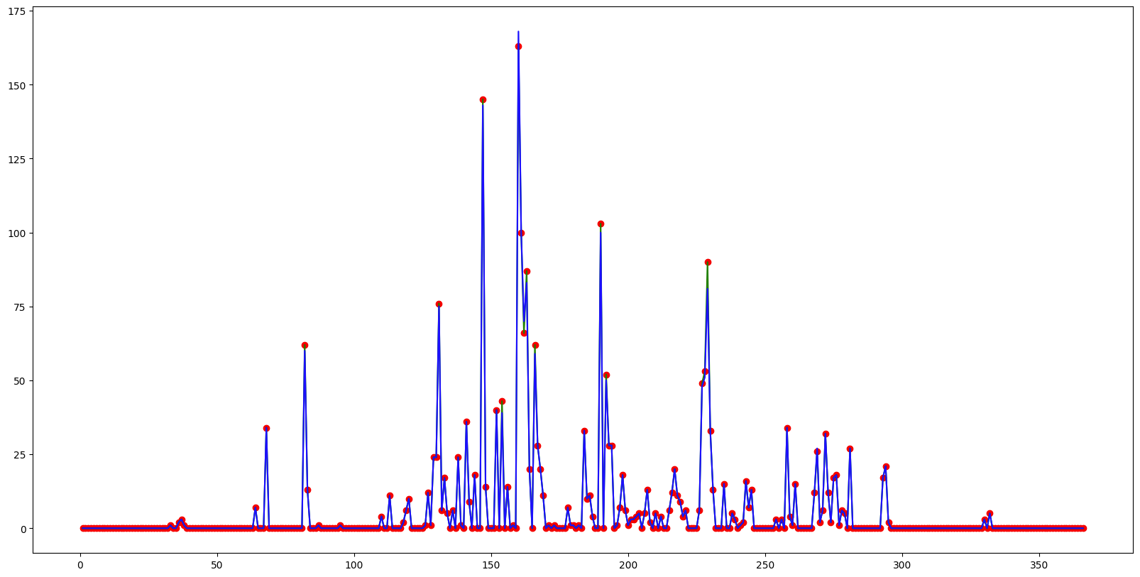
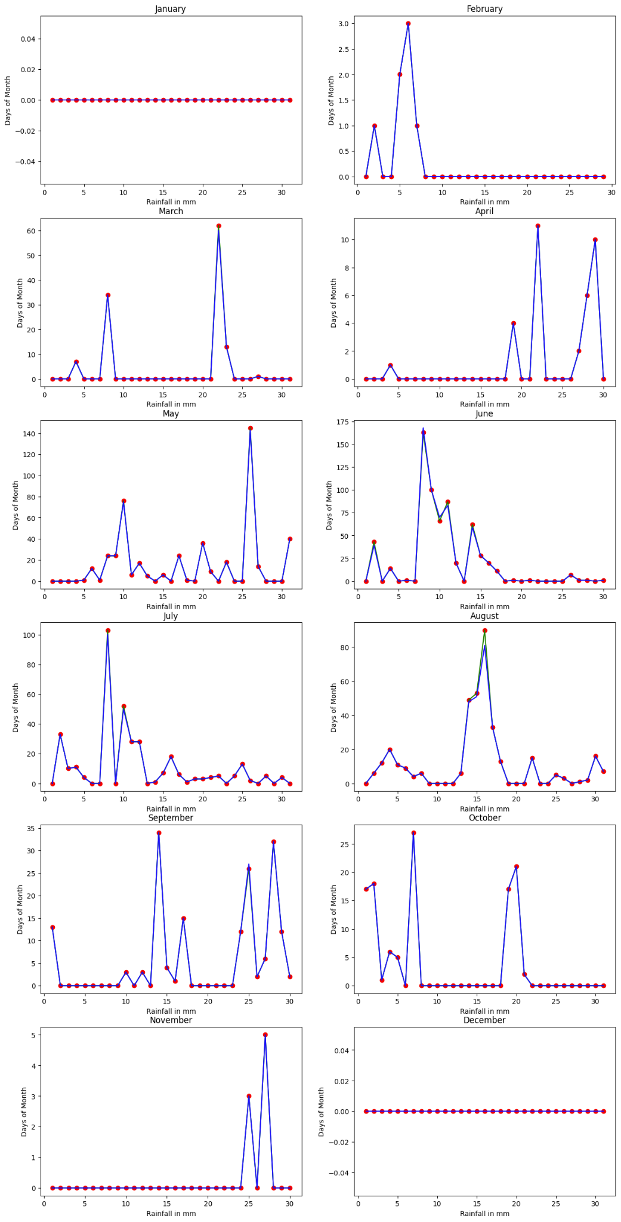
Results(SVM)
To obtain the training data, filter records up to 1975. For the test data, select records from 1976. Use the SVM model to train on the training data and make predictions on the test data.One graph shows rainfall data for each day across 12 months in 1976, covering up to 31 days per month. Another graph marks rainfall data at each station in 1976, with red dots showing test data points per station. A third graph includes additional factors—temperature, humidity, and sunshine—that contributed to the accuracy of the model. The SVM model showed the best accuracy on 1976 test data, with predicted values (blue) closely matching actual values (green).

Slide 14
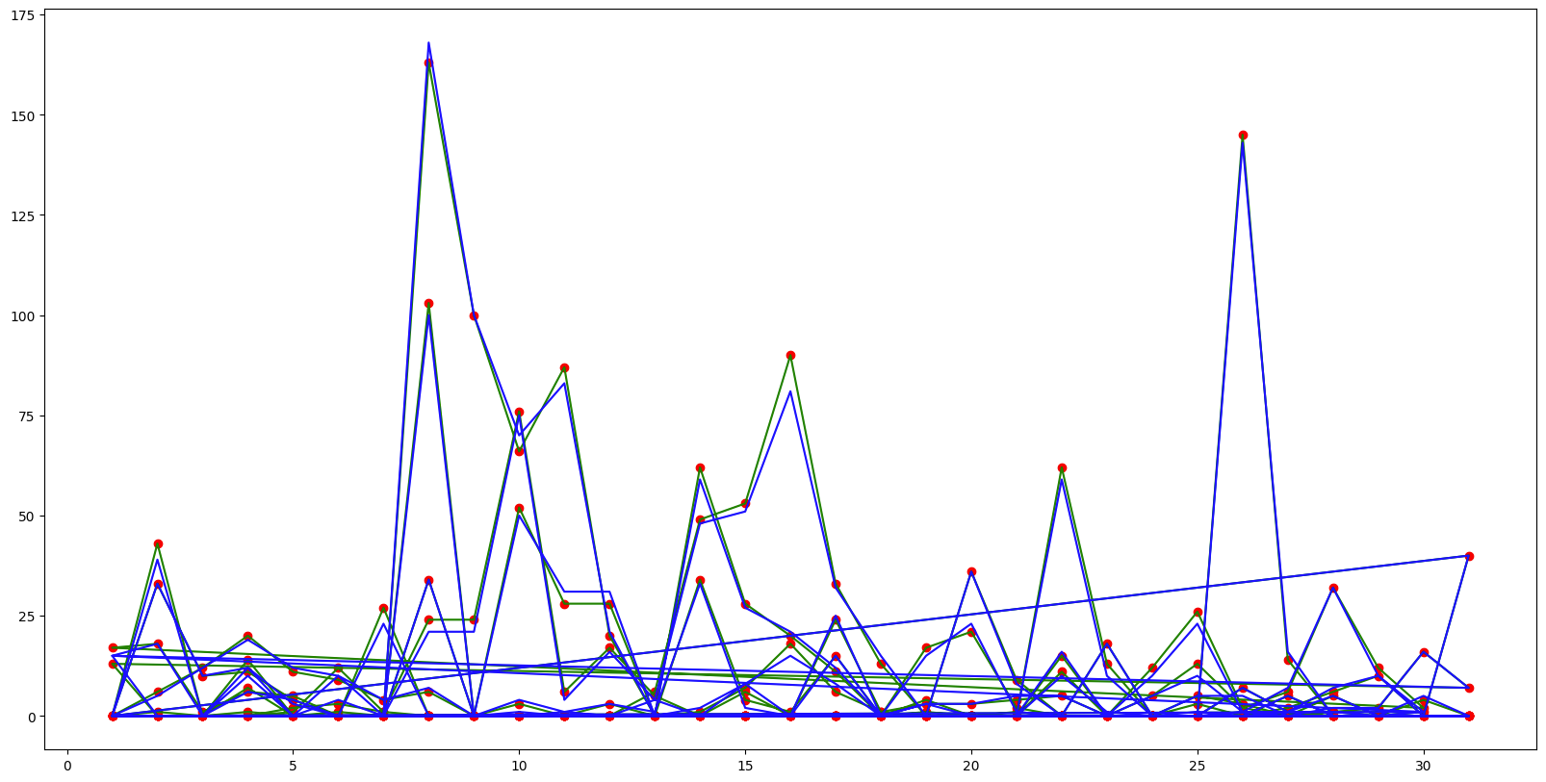
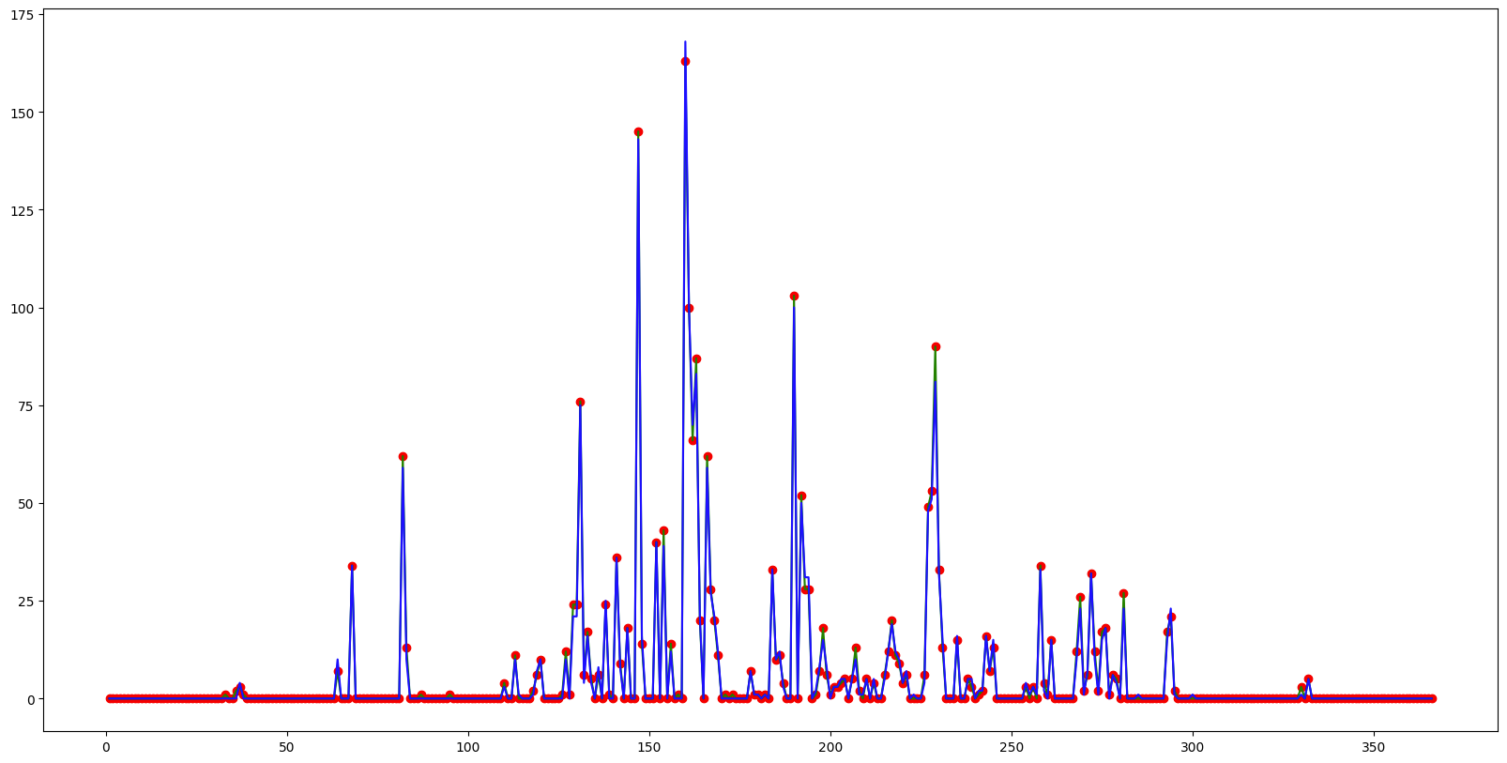
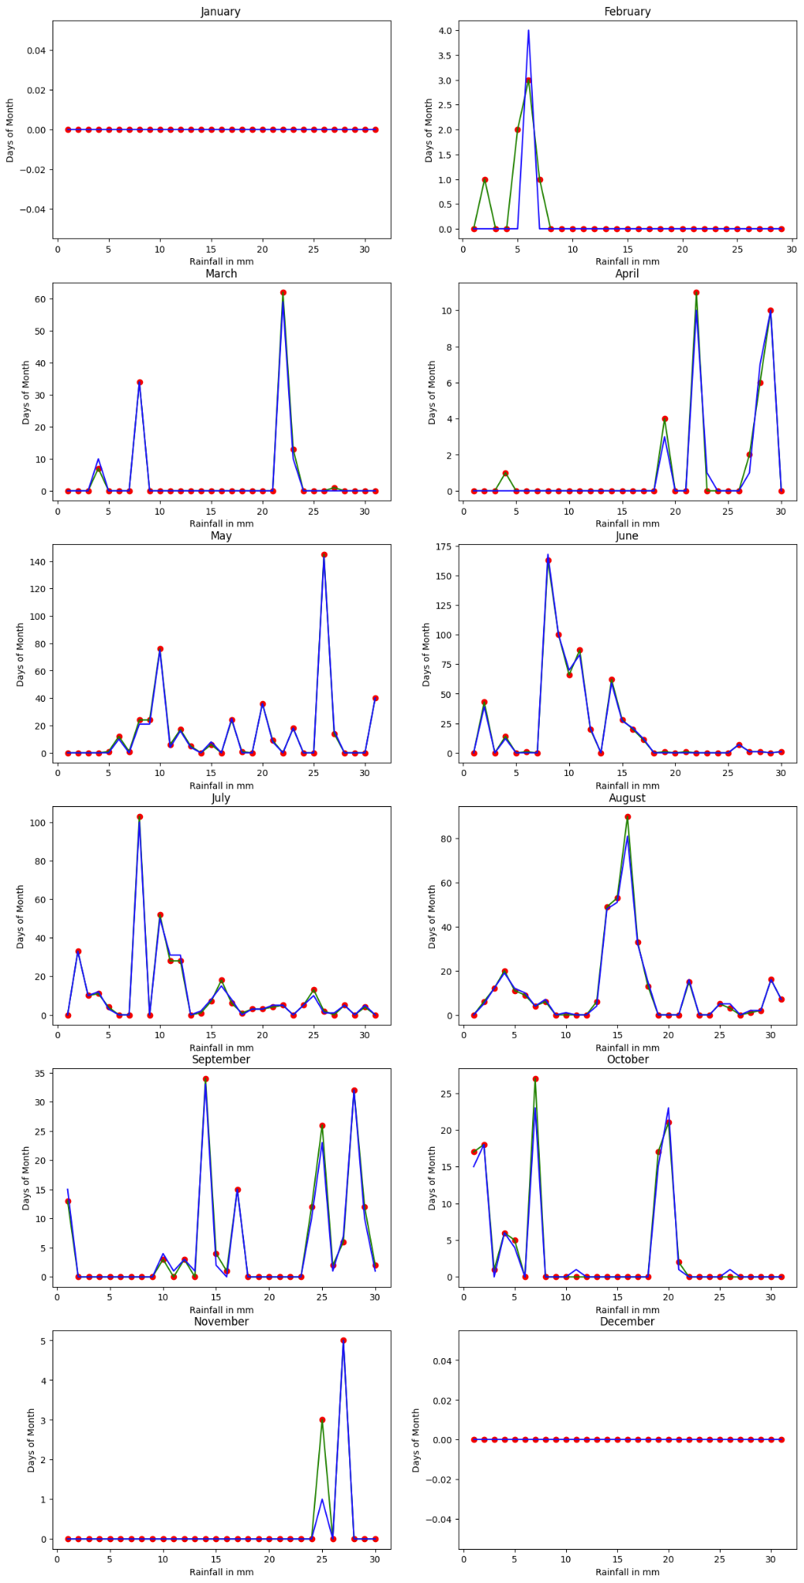
Results(KNN)
To obtain the training data, filter records up to 1975. For the test data, select records from 1976. Use the KNN model to train on the training data and make predictions on the test data. The outcome after using the KNN model was slightly worse than SVM. The first graph shows daily rainfall data for each month in 1976, covering up to 31 days. The second graph displays rainfall data for each station in 1976, with red dots marking test data points. The third graph includes extra factors like temperature, humidity, and sunshine, which help improve model accuracy.

Slide 15
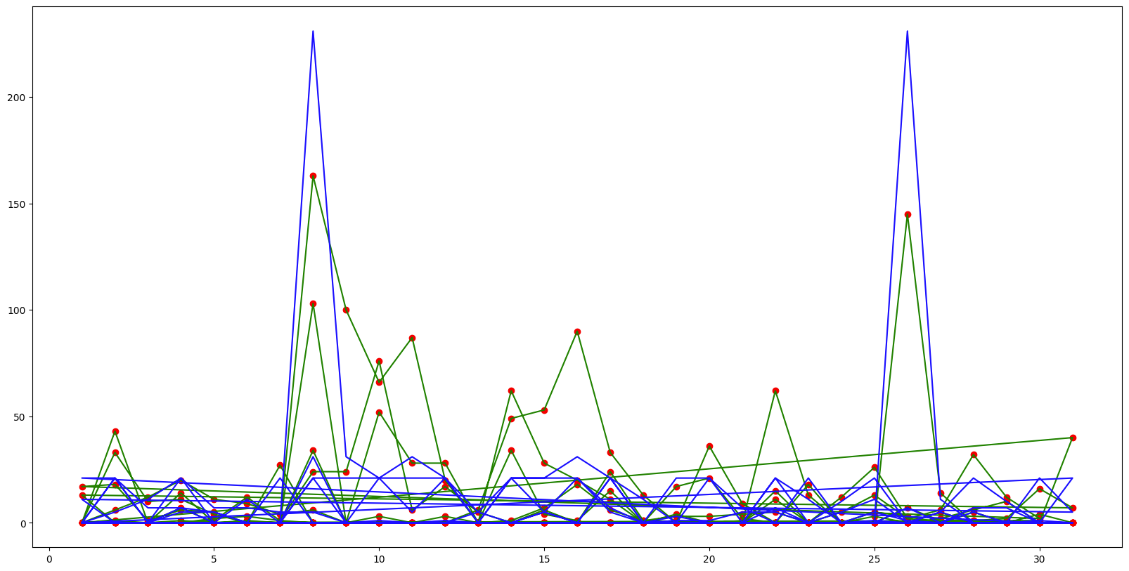
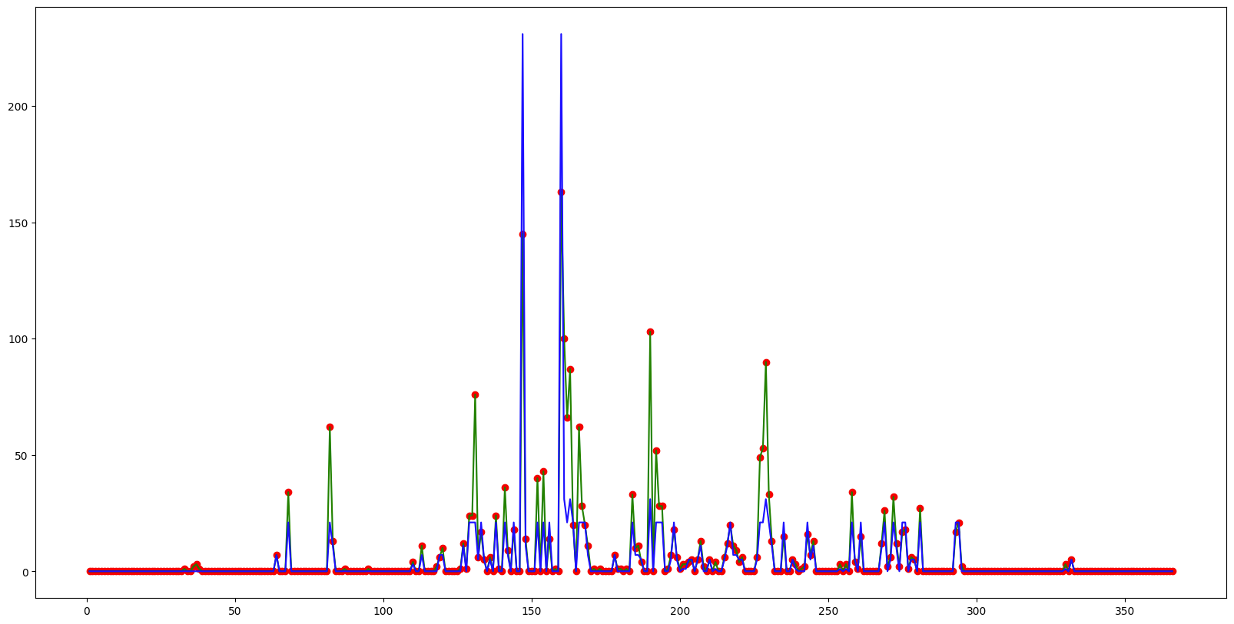
Results(MLP)
To obtain the training data, filter records up to 1975. For the test data, select records from 1976. Use the MLP model to train on the training data and make predictions on the test data .The first graph shows daily rainfall data for each month in 1976, covering up to 31 days. The second graph displays rainfall data for each station in 1976, with red dots marking test data points. The third graph includes extra factors like temperature, humidity, and sunshine, improving model accuracy . this line here write for KNN model only word used.

Slide 16
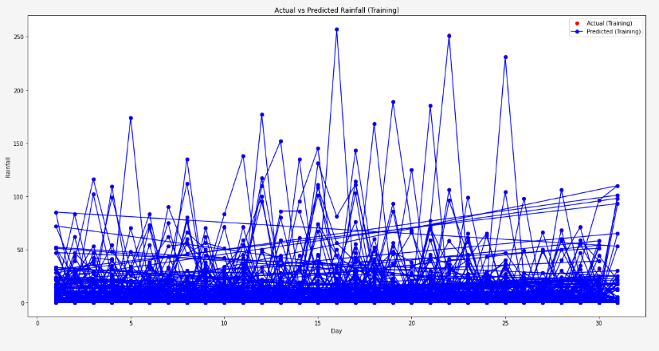
SVM(training Accuracy)
Mean Squared Error (MSE) on Training Data: 0.00933014863305414
R2 Score on Training Data: 0.9999652728615208

Slide 17
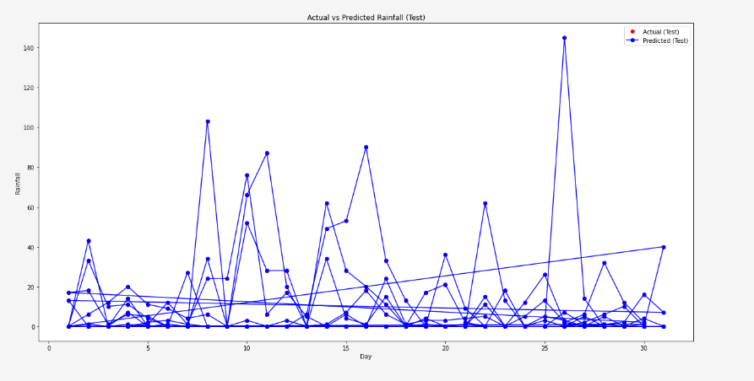
SVM(testing Accuracy)
Mean Squared Error (MSE) on Test Data: 0.009325603135048087
R2 Score on Test Data: 0.9999601728298172

Slide 18
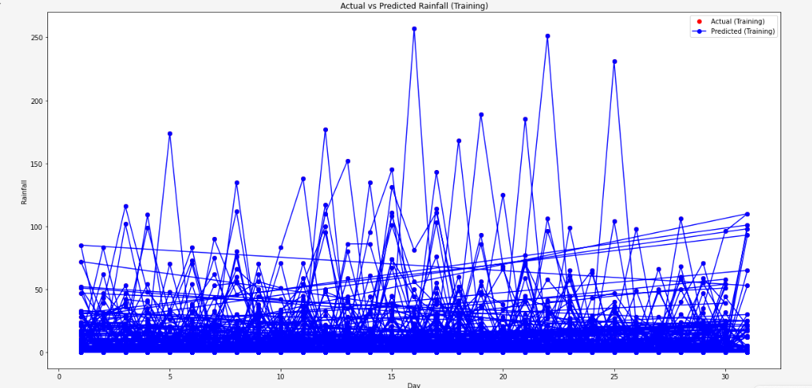
DecisionTree(training Accuracy)
Decision Tree Regression:
Training MSE: 0.0
Training R2 score: 1.0

Slide 19
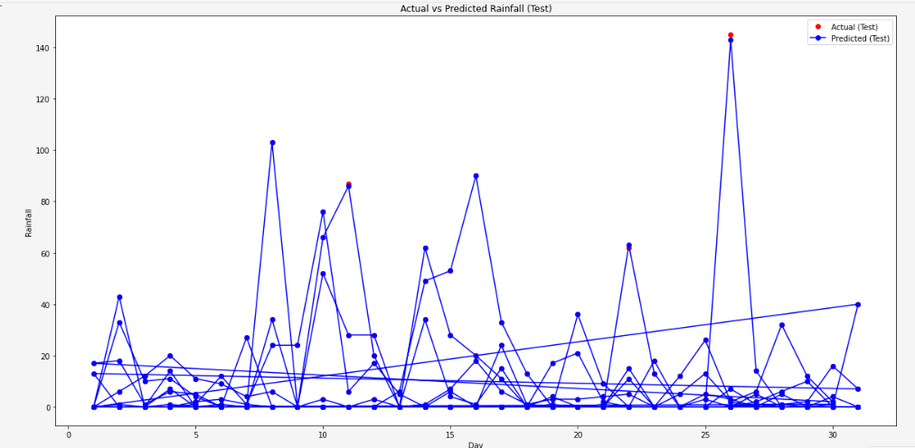
DecisionTree(testing Accuracy)
Test MSE: 0.01639344262295082
Test R2 score: 0.9999299879675587

Slide 20
Part B

Slide 21
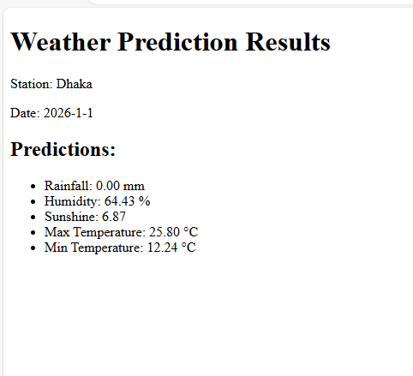
Weather Prediction Web application Results Overview:
Provided weather predictions for all districts in Bangladesh.
Covered a 12-month period, offering comprehensive yearly forecasts.
Displayed detailed results for each district, including:
Rainfall: Accurate measurement in millimeters.
Humidity: Precise percentage values.
Sunshine: Duration measured in hours.
Maximum Temperature: Highest expected temperature in degrees Celsius.
Minimum Temperature: Lowest expected temperature in degrees Celsius.

Slide 22
API Feature: 5-Day Weather Forecast
API Integration:
Enables users to access detailed 5-day weather forecasts.
Utilizes an external weather API for real-time data retrieval.
Forecast Features:
Rainfall Prediction (mm)
Humidity Levels (%)
Sunshine Duration (hours)
Maximum Temperature (°C)
Minimum Temperature (°C)
How It Works:
The home page provides two distinct options for users: "Real-time" and "API Forecast" modes. The "Real-time" mode delivers immediate weather insights based on live data, while the "API Forecast" mode offers a detailed 5-day forecast.
Using the location-based forecast feature, users can easily select their current location or desired area to generate personalized weather predictions. This ensures that the information is highly relevant to their needs.
Predictions are dynamically updated through integration with a trusted external API, guaranteeing accuracy and up-to-date results.

Slide 23



Data Collection and Processing:
We have acquired historical weather data from reliable sources and processed it to create structured datasets for model training and analysis. This involved data cleaning, formatting, and feature engineering to ensure the quality and relevance of the data.
Conclusion
Model Development and Training:
Five distinct machine learning models have been developed and trained using the processed data to predict different weather parameters, including rainfall, sunshine duration, humidity, maximum temperature, and minimum temperature. These models have undergone rigorous evaluation and validation to ensure their accuracy and reliability.
In conclusion, the development of the weather prediction application represents a comprehensive endeavor aimed at leveraging machine learning techniques to provide accurate and timely weather forecasts. Through this project, we have addressed the following key objectives
Future Work
In future, add an API feature in the web application. The home page will have two options: "Real-time" and "API Forecast." The API option will provide a 5-day forecast with five key features and allow users to select their current location.

Slide 24




THANK YOU

